Slide 1

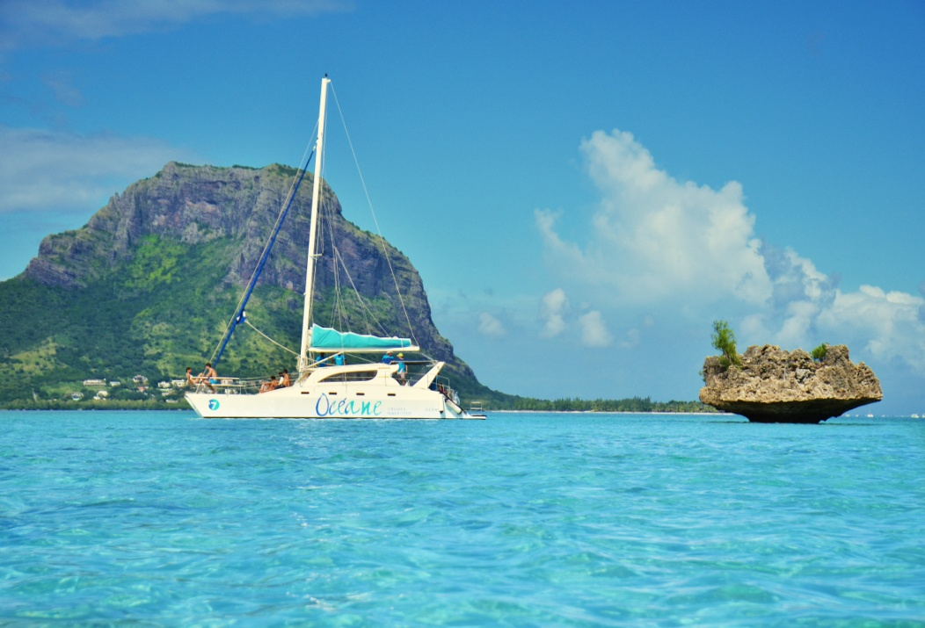
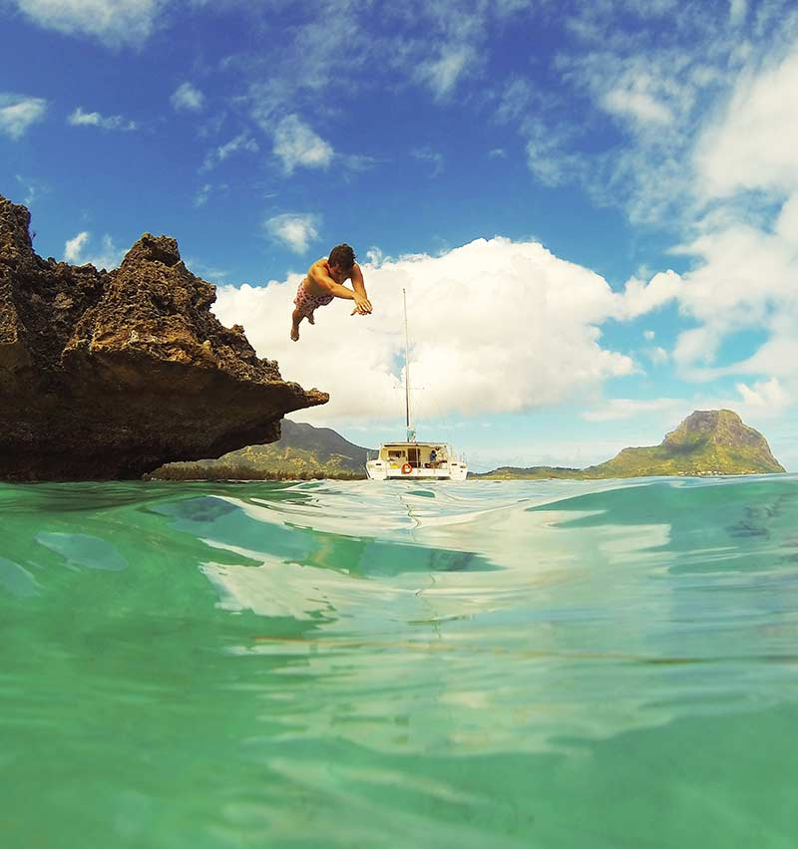
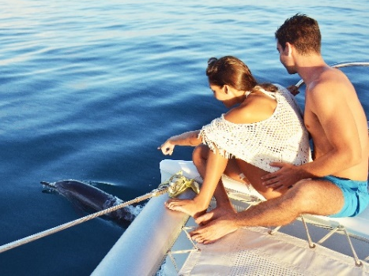
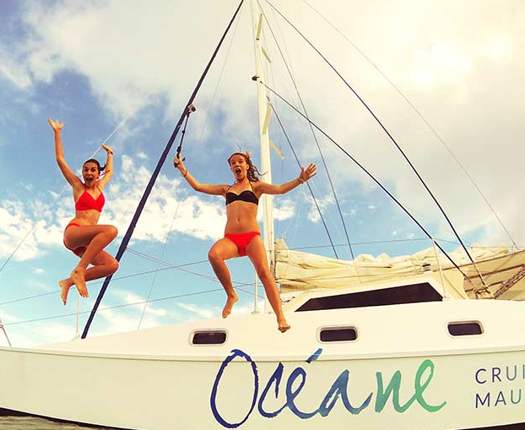
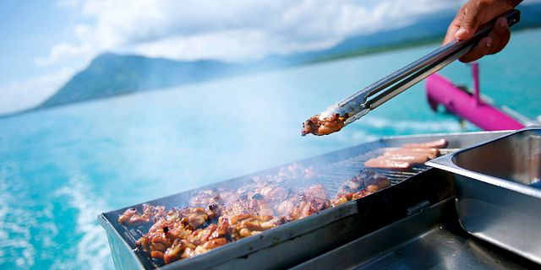
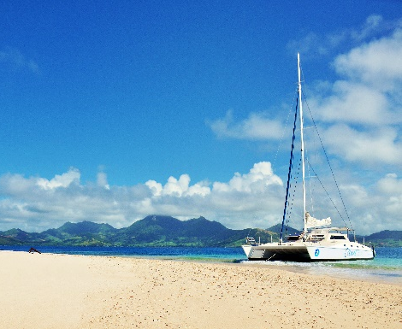
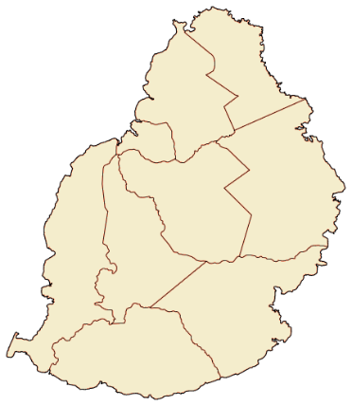

Catamaran West - Oceane
An unforgettable experience is awaiting you in our magnificent multicolored lagoons. You’ll navigate around our coasts in comfortable catamarans.
Navigate along the west coast, encounter dolphins and discover our marine fauna. Have a relaxing sunbath while the crew prepares your BBQ lunch.
Location | West coast of Mauritius
Minimum age | 3 years old
Operating days | Everyday
Activity Time | Approximately from 09:00 to 15:30
Transportation | Included in cost of excursion
Lunch | Included in cost of excursion
www.emotionsdmc.com

Slide 2
Catamaran West - Oceane
ITINERARY
09:00 - Embark at L’Estuaire - La Balise Marina, Black River
Dolphin Watch – Watch bottle-nosed or spinner dolphins
Snorkeling and Swimming – Discover the underwater marine life
BBQ Lunch & Drinks – Enjoy a succulent BBQ on board
Visit Ile Aux Benitiers – Time for a tan
15:30 – Back to Black River
LUNCH MENU – Standard BBQ Lunch and drinks
FOOD: BBQ Chicken & Fish, Garlic bread, Pasta Salad, Chayotte (chouchou) salad, sautéed eggplant with garlic, a platter of English cucumber, papaya, cabbage, pineapple, raisins, seasonal tropical dessert served on board
DRINKS: Local rum & local beers, local wine, lakour fresh juices, soft drinks, water
Note: Sharing basis does not include Lobster – no supplement is possible
  Exclusivity Basis will include: Grilled Lobster, South African Wine and Sparkling wine
PRACTICAL INFORMATION
Swimming Costume, Sun cream and towels are a must for this excursion
  Itinerary might be slightly modified depending on weather and sea conditions
  Snorkeling equipment except tubas will be provided on board in limited quantity. For sanitary reasons it is recommended to bring your own equipment.
  EMBARKATION POINT & TIME FOR SHARING TRANSFERS
  Embarkation on the west coast is at La Balise Marina, Black River, starting at 09:00 am
  The departure is at 9:15 am
  West Coast Cruise sharing transfer:
  Hotels in Flic & Flac and Tamarin = MUR 750 per person
  Hotels in Bel ombre = MUR 1200 per person
  Hotels in Le Morne = MUR 1000 per person
www.emotionsdmc.com

Slide 3
Catamaran West - Oceane
Rates Our rates are in MUR inclusive of 15% VAT - Validity: 01st of November 2024 to 31st of October 2025
Cost of Excursion Sharing Basis / Price per person |  | Public Rate
Standard Car | Single adult | 10,800
 | 2-3 adults | 7,800
Private Minibus | 4-8 adults | 6,100
 | Child (3-11 years) | 50% discount
Exclusivity (no transfer) |  | Public Rate
Catamaran up to 6 adults including F&B, Lobster, SA Wine and Sparkling Wine (catamaran capacity 24 pax max) |  | 62,400
Additional Adult (12+ yrs old) for exclusivity including F&B, Lobster, SA Wine and Sparkling Wine |  | 4,650
Additional child (3-11 yrs old) on exclusivity including food & beverages |  | 50% discount
Sharing without transfer |  | Public Rate
Adult |  | 3,500
Child (3-11 years) |  | 50% discount
Terms and Conditions No refund for pre-booked confirmed tour when guests cancel in Mauritius Exceptional waiving for pre-booked tour in case of bad weather without possibility of postponing due to restrictions of days 50% cancellation fee if tour is cancelled more than 24 hours prior to date of excursion 100% cancellation fee if tour is cancelled less than 24 hours prior to date of excursion When a tour is cancelled by the supplier due to bad weather and cannot be postponed before guest departure; a total refund is applicable If any activity is cancelled due to bad weather by the supplier and that guests have already left the hotel, a minimum fees for transport will be charged. Guests can convert the tour to a land excursion, hence no transportation refund will be applicable
www.emotionsdmc.com

